Slide 1
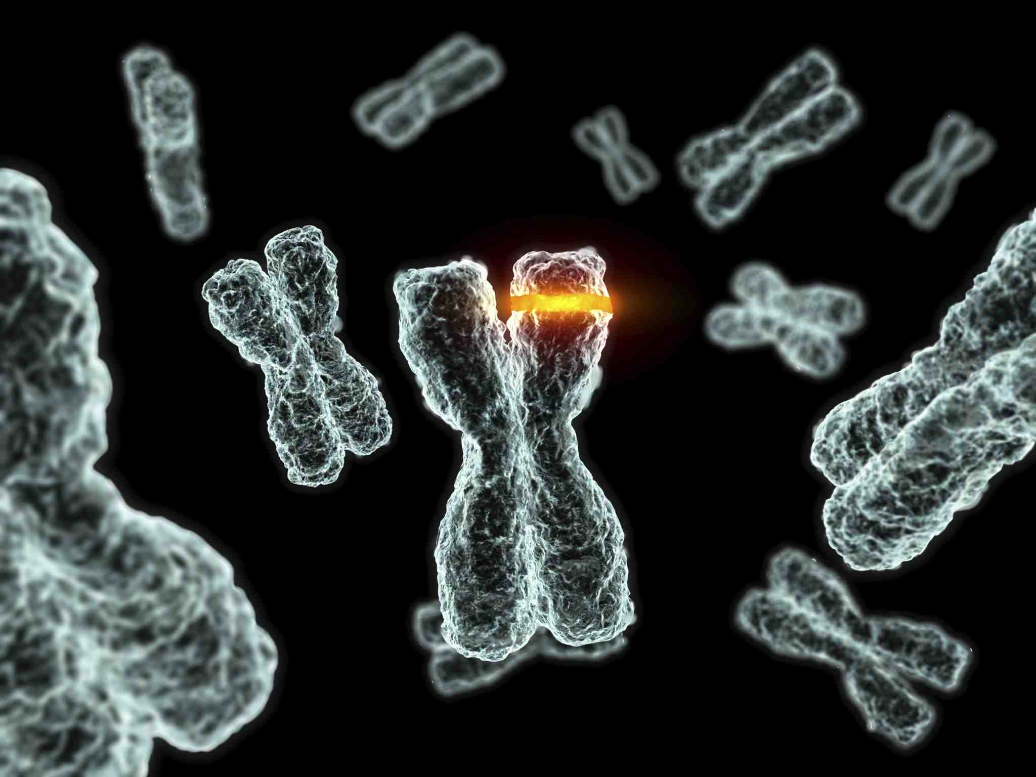
Fanconi Anemia
Anthony Winchell

Slide 2
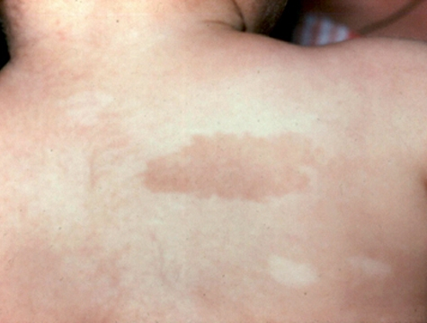
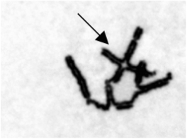
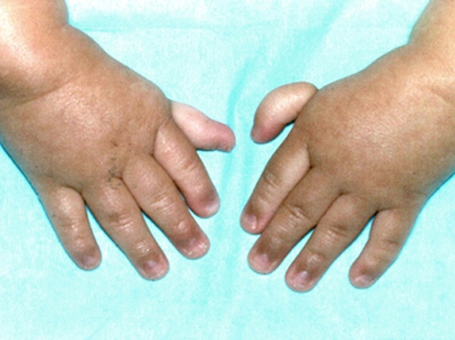
What is Fanconi Anemia?
http://www.sitemaker.umich.edu/nhowlett/files/fa-qr.gif

Slide 3
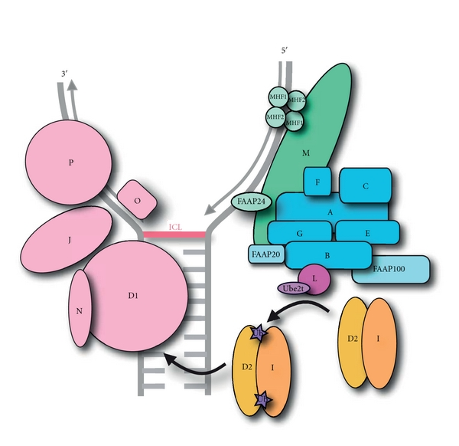
What is the Fanconi Anemia pathway?
http://www.hindawi.com/journals/anemia/2012/926787/

Slide 4
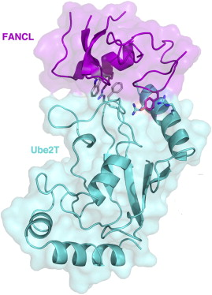
What is Fanconi Anemia Complementation Group L?
http://ghr.nlm.nih.gov/dynamicImages/chromomap/FANCL.jpeg

Slide 5
What role does FANCL play?
Cellular Components
Fanconi Anemia nuclear complex
Molecular Function
Ubiquitin-protein transferase activity
Biological Processes
Protein ubiquitination DNA Repair

Slide 6
How well conserved is FANCL?

Slide 7
Knowledge Gap : Why do FANCL-caused FA patients have such varying phenotypes?
Understand how different mutations affect phenotype and ID complex ubiquitination.

Slide 8
Hypothesis
Mutations occurring in the WD40 domain will have a greater effect on phenotype than mutations to the RING finger domain.

Slide 9
Aim I
Aim II
Aim III
Identify binding partners of FANCL that have a role in skin pigmentation

Slide 10
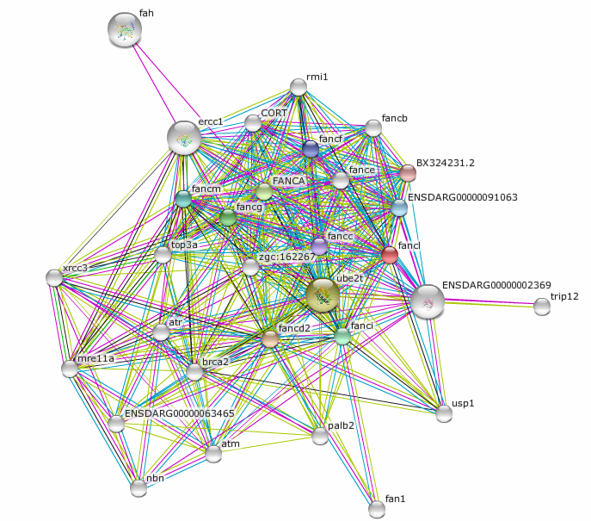
Aim I: Approach
Find binding partners in STRING related to skin pigmentation
Utilize the CRISPER/Cas9 system to mutate these genes to confirm

Slide 11
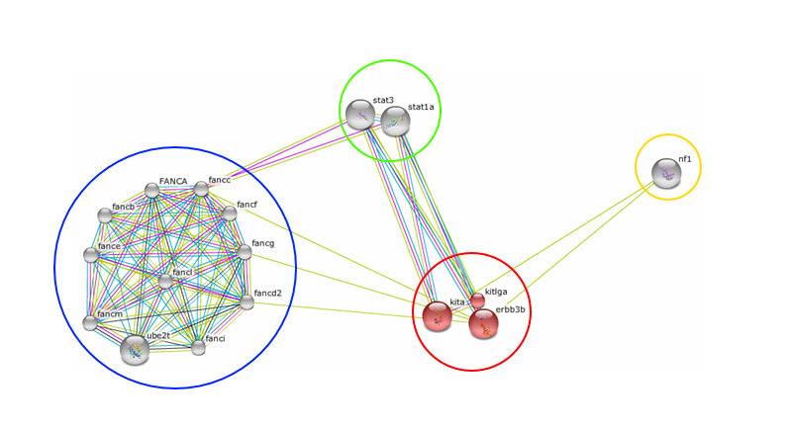
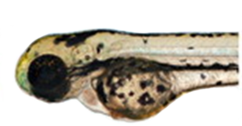
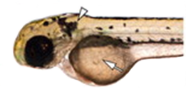
Aim I: Results
kita identified as key pigmentation gene
Transcription Factors
Neurofibromatotis
Type I
FA Complex
BF: pigmentation
Mills et al., 2007 - Deconstructing evolution of adult phenotypes: genetic analyses of kit reveal homology and evolutionary novelty during adult pigment pattern development of Danio fishes. Development 134(6):1081-1090

Slide 12
Aim I
Aim II
Aim III
Determine which domain plays a more prominent role in pigmentation

Slide 13
Aim II: Approach
Identify conserved regions in the WD40 and RING domains.
WD-Repeat Domain
RING Domain
Utilize the CRISPER/Cas9 system to induce site specific mutations

Slide 14
Aim II: Expected Results
WD40-mutant transgenic lines will have more mutant Zebrafish

Slide 15
Aim I
Aim II
Aim III
Quantify the level of ubiquitination in each transgenic line

Slide 16
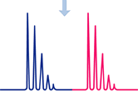
Aim III: Approach
Utilize quantitative mass spec to quantify levels of ubiquitination

Slide 17
Aim III: Expected Results
WD40-mutant transgenic lines will have reduced ubiquitination

Slide 18
Future Directions
Relationship between FA, KIT, and pigmentation
Binding between core complex proteins

Slide 19
Questions?

